Slide 1
Project Presentation
CSE 4622:
ML Lab

Slide 2
Team Members
Ishmam tashdeed
01
See it learn:
a machine learning algorithm visualizer
Tauseef Tajwar
02
Muftiqur rahman
03
Md farhan ishmam
04
180041105
180041109
180041111
180041120

Slide 3
Humans are visual creatures
Notes:
The human brain is not well equipped to devour so much raw, unorganized information such as large corpus of texts. Humans are visual learners i.e. we happen to retain information more efficiently from visual sources than other sources such as reading, hearing etc.

Slide 4
We are designed to learn visually!
Half of the brain is directly or indirectly devoted to processing visual information.
The brain can identify images seen for as little as 13 milliseconds.
People can remember more than 2000 pictures with at least 90% accuracy in recognition tests.

Slide 5
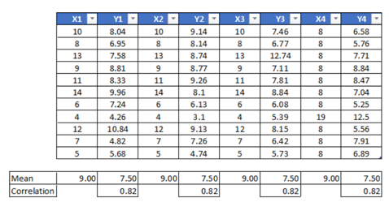
Tables aren’t meant to be comprehensible…
Notes:
Let’s have a look at the most common form of structures data - a table. When we look at it, all our brain sees is just a bunch of numbers. We think over and over again what these numbers mean and may or may not come up with some reasonable explanation depending on our mental aptitude. But the point remains the same – it is unpleasant to look at and inferring from the table is inefficient.

Slide 6
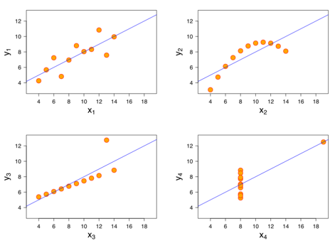
Visualization has more information!
Notes:
Now what can we see? Almost everything that was happening in the table and maybe more. All in the blink of an eye. If I change the slide right now, you will remember most of the information from the visualization. But did you remember anything from the table? [Introduce the next speaker]

Slide 7
What we see
Description of Linear Classifier Decision Boundaries:
The linear classifier model draws a linear boundary between regions
of dissimilarity. In case of having two dissimilar cases, the final boundary will be a straight line that divides the whole region in two parts. The linear boundary is calculated based on the weight and as the weights starts off with zero, the linear boundary will also be at the x-axis i,e, it is producing zero as output for every value of x. As the model gets trained, the linear boundary iteratively gets closer to the actually dividing regions of dissimilarity. The linear boundary tends to change rapidly at the beginning but begins to lose it’s pace as it reaches close to the global minimum.
Notes:
Here’s, another example but this time, with a large corpus of text; something which we commonly see in our books and slides. What do we see?

Slide 8
What we actually see
Description of Linear Classifier Decision Boundaries:
The linear classifier model draws a linear boundary between regions
of dissimilarity. In case of having two dissimilar cases, the final boundary will be a straight line that divides the whole region in two parts. The linear boundary is calculated based on the weight and as the weights starts off with zero, the linear boundary will also be at the x-axis i,e, it is producing zero as output for every value of x. As the model gets trained, the linear boundary iteratively gets closer to the actually dividing regions of dissimilarity. The linear boundary tends to change rapidly at the beginning but begins to lose it’s pace as it reaches close to the global minimum.
Notes:
But here’s what’s actually happening! We don’t focus on every piece of text in the paragraph. We can’t remember every single word! We just try to find the important ones to remember and may or may not find all the important ones. Here the words marked in red seem reasonable enough to be considered important by an average use but the line in blue is something that might get ignored which does have a lot of importance when trying to conceptualize the algorithm.

Slide 9
Instead let’s just do this..
Notes:
We focus on certain parts only. Important or unimportant, we don’t know that yet. In the limited amount of time we have, we take the gamble of finding the correct words to focus in time. Then we try to conceptualize the whole thing visually. But why do we need to do all these extra steps and instead just….

Slide 10
Our objectives
Provide a tool that can visualize machine learning algorithms and provide students to interact with them.
Quality visualization with animation where possible.
Being easily interactive and conceptually intuitive.
A study environment where the student can have a visual understanding and emerge himself/herself in the learning process.
Notes:
Now, we know the problem. Our education system is entangled in such a non-visual study methodology. And here, comes our solution.

Slide 11
Core features
Best form of visualization for popular machine learning algorithms.
9 randomly generated datasets of various shapes.
9 learning algorithms and can be modularly extended.
Interactive widgets to change hyperparameters.

Slide 12
language
platform
Python
Most popular language for ML
Lots of open-source and optimized ML algorithms
Great community support
Jupyter Notebook
Web-based and interactive
Supports code, text, and rich media
Great deployment environment and easily replicable
Notes:
[Change of Speaker]

Slide 13
Python libraries used
Front-end
Deployment
Backend
Ipywidgets
Ipython
Matplotlib
Seaborn
Numpy
Pandas
Scipy
Scikit-Learn
Appmode

Slide 14
algorithms

Slide 15
01
Linear regression
02
Logistic regression
03
Neural networks
Supervised Learning algorithms
04
Linear svm
05
Non-linear svm
06
Naive Bayes
07
Decision tree

Slide 16
01
K-Means clustering
unSupervised Learning algorithms
02
Principal component analysis (PCA)

Slide 17
Demo!

Slide 18
Thanks

